Slide 1
Discrete random variables

Slide 2
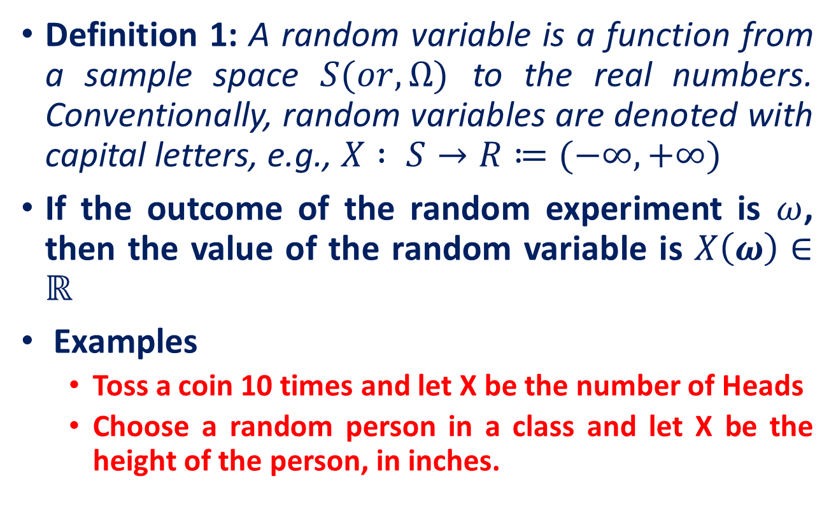
Recall: Random Variable
Definition 1: A random variable is a function from a sample space $S(or, Ω)$ to the real numbers. Conventionally, random variables are denoted with capital letters, e.g., $X : S→R≔(−∞,+∞)$
If the outcome of the random experiment is $ω$, then the value of the random variable is $X\left(ω\right)∈ℝ$
Examples
Toss a coin 10 times and let X be the number of Heads
Choose a random person in a class and let X be the height of the person, in inches.

Slide 3
Recall: Discrete Random Variable
Random variables that can assume a countable number (finite or infinite) of values are called discrete.
Examples
Experiment
Random Variable
Possible Values
Make 100 Sales Calls
# Sales
0, 1, 2, ..., 100
Inspect 70 Radios
# Defective
0, 1, 2, ..., 70
Answer 33 Questions
# Correct
0, 1, 2, ..., 33

Slide 4
Recall: Continuous Random Variable
A continuous random variable is a random variable with infinitely many possible values (in an interval of real numbers ).
Experiment
Random Variable
Possible Values
Weigh 100 People
Weight
45.1, 78, ...
Measure time taken
Hours
900, 875.9, ...
Amount spent on food
$ amount
54.12, 42, ...
Measure Time
Inter-Arrival
0, 1.3, 2.78, ...
Between Arrivals
Time

Slide 5
Recall: Probability Distributions
Definition: Probability Distribution
A probability distribution of a random variable X is a description of the probabilities associated with the possible values of X
Example
Let X = # of heads observed when a coin is flipped twice
Number of Heads | 0 | 1 | 2
Probability | 1/4 | 2/4 | 1/4

Slide 6
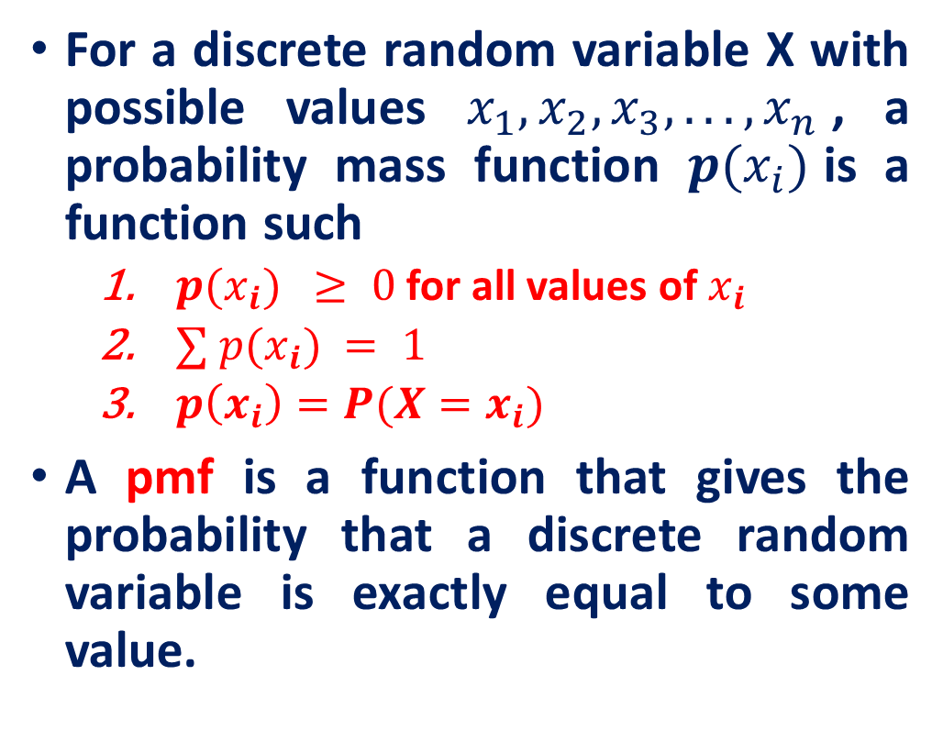
Recall: Probability Mass Function (PMF)
Example (Probability Mass Function (PMF)): Tossing a die
For a discrete random variable X with possible values $x_{1}, x_{2}, x_{3}, . . . , x_{n}$, a probability mass function $p(x_{i})$is a function such
$p(x_{i}) ≥ 0$ for all values of $x_{i}$
$∑ p(x_{i}) = 1$
$p\left(x_{i}\right)=P(X=x_{i})$
A pmf is a function that gives the probability that a discrete random variable is exactly equal to some value.
x
p(x)
1
p(x=1)=1/6
2
p(x=2)=1/6
3
p(x=3)=1/6
4
p(x=4)=1/6
5
p(x=5)=1/6
6
p(x=6)=1/6
1.0

Slide 7
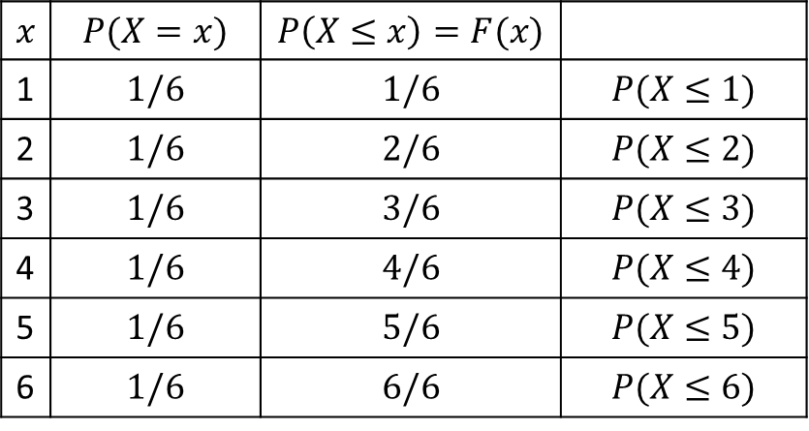
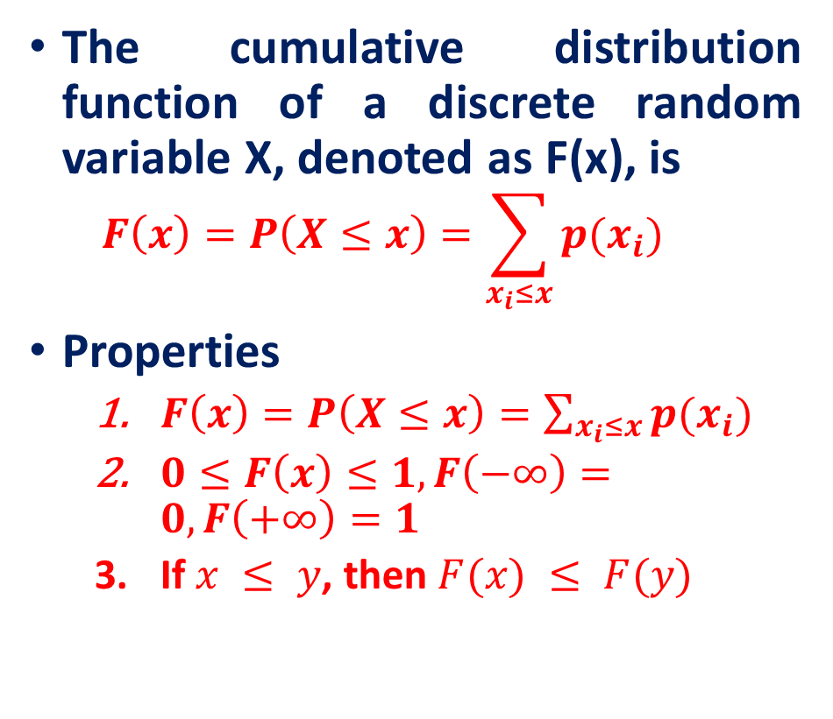
Recall: Cumulative Distribution Function (CDF)
The cumulative distribution function of a discrete random variable X, denoted as F(x), is
$$F\left(x\right)=P\left(X≤x\right)=\sum_{x_{i}≤x}{p(x_{i})}$$
Properties
$F\left(x\right)=P\left(X≤x\right)=\sum_{x_{i}≤x}{p(x_{i})}$
$0≤F\left(x\right)≤1, F\left(−∞\right)=0, F\left(+∞\right)=1$
If $x ≤ y$, then $F(x) ≤ F(y)$
Example (CDF): Tossing a die
$$x$$ | $$P(X=x)$$ | $$P\left(X≤x\right)=F(x)$$
1 | $$1/6$$ | $$1/6$$ | $$P(X≤1)$$
2 | $$1/6$$ | $$2/6$$ | $$P(X≤2)$$
3 | $$1/6$$ | $$3/6$$ | $$P(X≤3)$$
4 | $$1/6$$ | $$4/6$$ | $$P(X≤4)$$
5 | $$1/6$$ | $$5/6$$ | $$P(X≤5)$$
6 | $$1/6$$ | $$6/6$$ | $$P(X≤6)$$

Slide 8
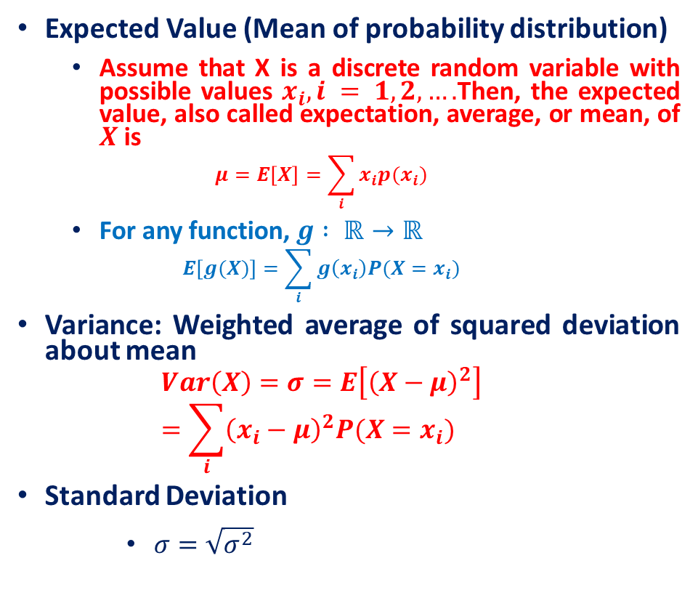
Recall: Summary Measures
Expected Value (Mean of probability distribution)
Assume that X is a discrete random variable with possible values $x_{i}, i = 1, 2,….$Then, the expected value, also called expectation, average, or mean, of $X$is
$$μ=E\left[X\right]=\sum_{i}{x_{i}p(x_{i})}$$
For any function, $g : ℝ→ℝ$
$$E\left[g(X)\right]=\sum_{i}{g\left(x_{i}\right)P(X=x_{i})}$$
Variance: Weighted average of squared deviation about mean
$$Var\left(X\right)=σ=E\left[{\left(X−μ\right)}^{2}\right]=\sum_{i}{{\left(x_{i}−μ\right)}^{2}P(X=x_{i})}$$
Standard Deviation
$σ=\sqrt{σ^{2}}$

Slide 9
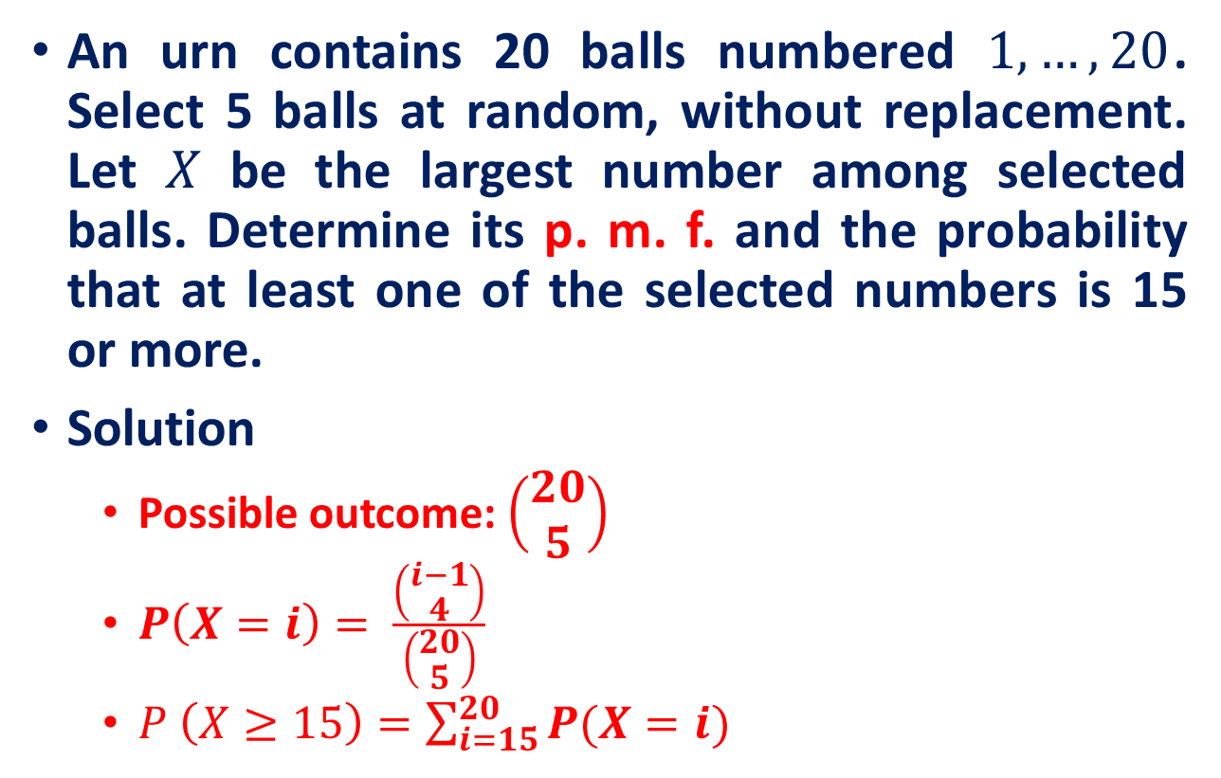
Example
An urn contains 20 balls numbered $1,…, 20$. Select 5 balls at random, without replacement. Let $X$ be the largest number among selected balls. Determine its p. m. f. and the probability that at least one of the selected numbers is 15 or more.
Solution
Possible outcome: $\left(\begin{matrix}20 \\ 5\end{matrix}\right)$
$P\left(X=i\right)= \frac{\left(\begin{aligned}i−1 \\ 4\end{aligned}\right)}{\left(\begin{aligned}20 \\ 5\end{aligned}\right)}$
$P \left(X≥15\right)=\sum_{i=15}^{20}{P(X=i)}$

Slide 10
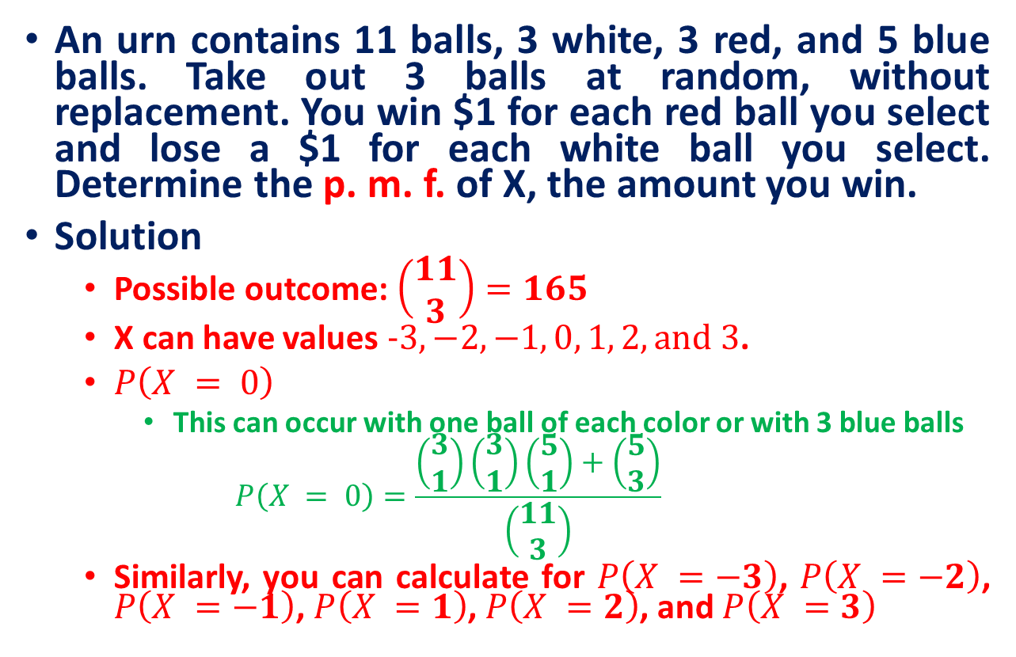
Example
An urn contains 11 balls, 3 white, 3 red, and 5 blue balls. Take out 3 balls at random, without replacement. You win $1 for each red ball you select and lose a $1 for each white ball you select. Determine the p. m. f. of X, the amount you win.
Solution
Possible outcome: $\left(\begin{matrix}11 \\ 3\end{matrix}\right)=165$
X can have values $−3, −2, −1, 0, 1, 2, and 3$.
$P\left(X = 0\right)$
This can occur with one ball of each color or with 3 blue balls
$$P\left(X = 0\right)=\frac{\left(\begin{aligned}3 \\ 1\end{aligned}\right)\left(\begin{aligned}3 \\ 1\end{aligned}\right)\left(\begin{aligned}5 \\ 1\end{aligned}\right)+\left(\begin{aligned}5 \\ 3\end{aligned}\right)}{\left(\begin{aligned}11 \\ 3\end{aligned}\right)}$$
Similarly, you can calculate for $P\left(X =−3\right)$, $P\left(X =−2\right)$, $P\left(X =−1\right)$, $P\left(X =1\right)$, $P\left(X =2\right)$, and $P\left(X =3\right)$

Slide 11
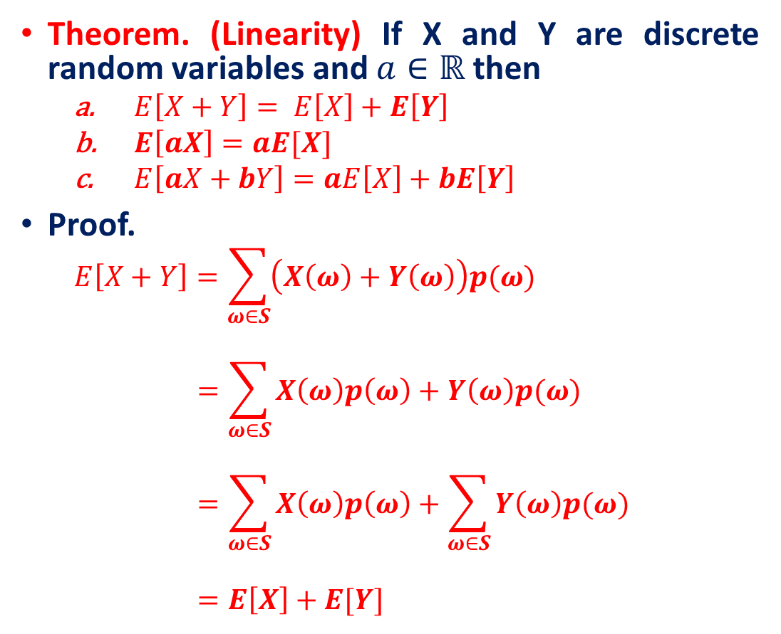
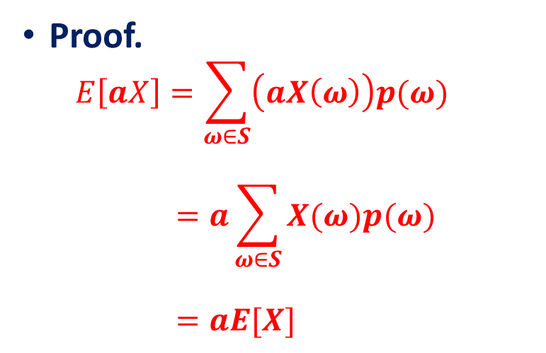
Expected Value
Theorem. (Linearity) If X and Y are discrete random variables and $a∈ℝ$then
$E\left[X+Y\right]= E\left[X\right]+E\left[Y\right]$
$E\left[aX\right]=aE[X]$
$E\left[aX+bY\right]=aE\left[X\right]+bE\left[Y\right]$
Proof.
$$E\left[X+Y\right]=\sum_{ω∈S}{\left(X\left(ω\right)+Y\left(ω\right)\right)p(ω)}$$
$$=\sum_{ω∈S}{X\left(ω\right)p\left(ω\right)+Y\left(ω\right)p(ω)}$$
$$=\sum_{ω∈S}{X\left(ω\right)p\left(ω\right)}+\sum_{ω∈S}{Y\left(ω\right)p(ω)}$$
$$=E\left[X\right]+E[Y]$$
Proof.
$$E\left[aX\right]=\sum_{ω∈S}{\left(aX\left(ω\right)\right)p(ω)}$$
$$=a\sum_{ω∈S}{X(ω)p(ω)}$$
$$=aE[X]$$

Slide 12
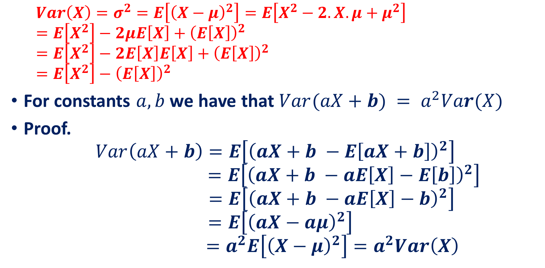
Variance
$$Var\left(X\right)=σ^{2}=E\left[{\left(X−μ\right)}^{2}\right]=E\left[X^{2}−2.X.μ+μ^{2}\right]$$
$$=E\left[X^{2}\right]−2μE\left[X\right]+{\left(E\left[X\right]\right)}^{2}$$
$$=E\left[X^{2}\right]−2E\left[X\right]E\left[X\right]+{\left(E\left[X\right]\right)}^{2}$$
$$=E\left[X^{2}\right]−{\left(E\left[X\right]\right)}^{2}$$
For constants $a, b$ we have that $Var(aX+b) = a^{2}Var(X)$
Proof.
$$Var\left(aX+b\right)=E\left[{\left(aX+b −E\left[aX+b\right]\right)}^{2}\right]$$
$$=E\left[{\left(aX+b −aE\left[X\right]−E\left[b\right]\right)}^{2}\right]$$
$$=E\left[{\left(aX+b −aE\left[X\right]−b\right)}^{2}\right]$$
$$=E\left[{\left(aX−aμ\right)}^{2}\right]$$
$$=a^{2}E\left[{\left(X−μ\right)}^{2}\right]=a^{2}Var\left(X\right)$$

Slide 13
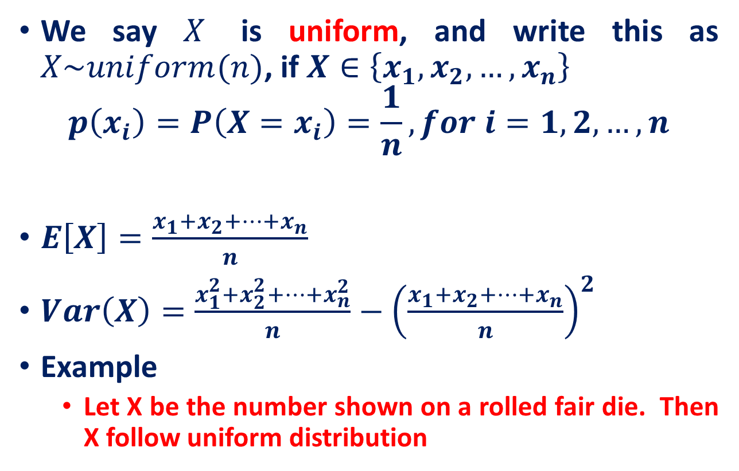
Uniform discrete random variable
We say $X$ is uniform, and write this as $X\sim uniform(n)$, if $X∈\left\{x_{1},x_{2},…,x_{n}\right\}$
$$p\left(x_{i}\right)=P\left(X=x_{i}\right)=\frac{1}{n}, for i=1,2,…,n$$
$E\left[X\right]=\frac{x_{1}+x_{2}+…+x_{n}}{n}$
$Var\left(X\right)=\frac{x_{1}^{2}+x_{2}^{2}+…+x_{n}^{2}}{n}−{\left(\frac{x_{1}+x_{2}+…+x_{n}}{n}\right)}^{2}$
Example
Let X be the number shown on a rolled fair die. Then X follow uniform distribution

Slide 14
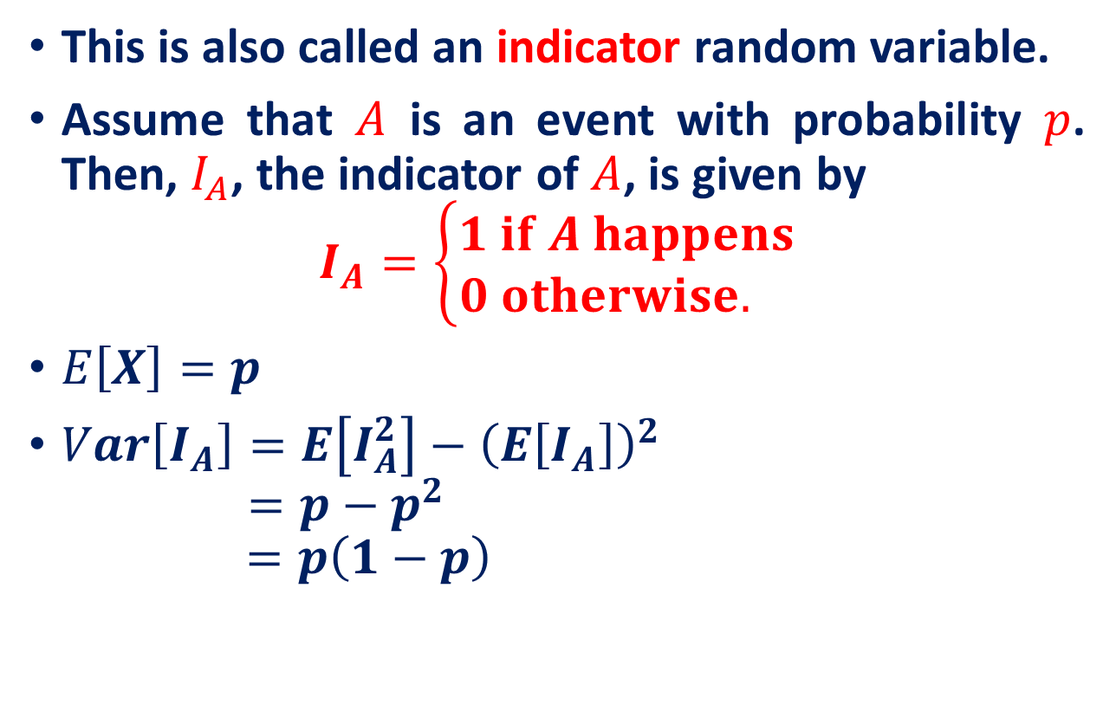
Bernoulli random variable
This is also called an indicator random variable.
Assume that $A$ is an event with probability $p$. Then, $I_{A}$, the indicator of $A$, is given by
$$I_{A}=\left\{\begin{aligned}1 if A happens \\ 0 otherwise. \end{aligned}\right.$$
$E\left[X\right]=p$
$Var\left[I_{A}\right]=E\left[I_{A}^{2}\right]−{\left(E\left[I_{A}\right]\right)}^{2}$
$$=p−p^{2}$$
$$=p\left(1−p\right)$$

Slide 15

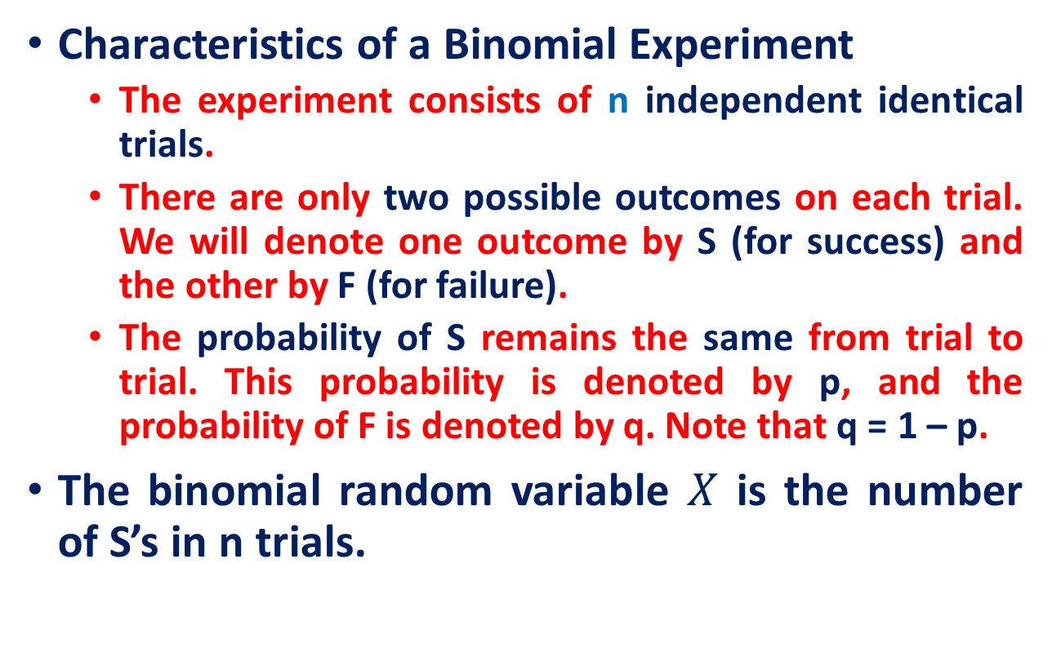
Binomial random variable
Characteristics of a Binomial Experiment
The experiment consists of n independent identical trials.
There are only two possible outcomes on each trial. We will denote one outcome by S (for success) and the other by F (for failure).
The probability of S remains the same from trial to trial. This probability is denoted by p, and the probability of F is denoted by q. Note that q = 1 – p.
The binomial random variable $X$ is the number of S’s in n trials.
$$P\left(X=i\right)=\left(\begin{aligned}n \\ i\end{aligned}\right)p^{i}{\left(1−p\right)}^{n−i},$$

Slide 16

Binomial example
Take the example of 5 coin tosses. What’s the probability that you flip exactly 3 heads in 5 coin tosses?
Outcome Probability
THHHT (1/2)³ $×$ (1/2)²
HHHTT (1/2)³ $×$ (1/2)²
TTHHH (1/2)³ $×$ (1/2)²
HTTHH (1/2)³ $×$ (1/2)²
HHTTH (1/2)³ $×$ (1/2)²
THTHH (1/2)³ $×$ (1/2)²
HTHTH (1/2)³ $×$ (1/2)²
HHTHT (1/2)³ $×$ (1/2)²
THHTH (1/2)³ $×$ (1/2)²
HTHHT (1/2)³ $×$ (1/2)²
10 arrangements $×$ (1/2)³ $×$ (1/2)²
ways to arrange 3 heads in 5 trials
The probability of each unique outcome (note: they are all equal)
5!/3!2! = 10

Slide 17

Binomial example
P(3 heads and 2 tails) = $\left(\begin{aligned}5 \\ 2\end{aligned}\right)×p{\left(H\right)}^{3}×p{\left(T\right)}^{2}$
$$=10×{\left(\frac{1}{2}\right)}^{5}=0.3125$$

Slide 18
Binomial example
You’re a telemarketer selling service contracts for Jio. You’ve sold 20 in your last 100 calls (p = .20). If you call 12 people tonight, what’s the probability of
No sales?
Exactly 2 sales?
At most 2 sales?
At least 2 sales?

Slide 19
Binomial example
n = 12, p = .20
p(0) = .0687
p(2) = .2835
p(at most 2) = p(0) + p(1) + p(2) = .0687 + .2062 + .2835 = .5584
p(at least 2) = p(2) + p(3)...+ p(12) = 1 – [p(0) + p(1)] = 1 – .0687 – .2062 = .7251

Slide 20
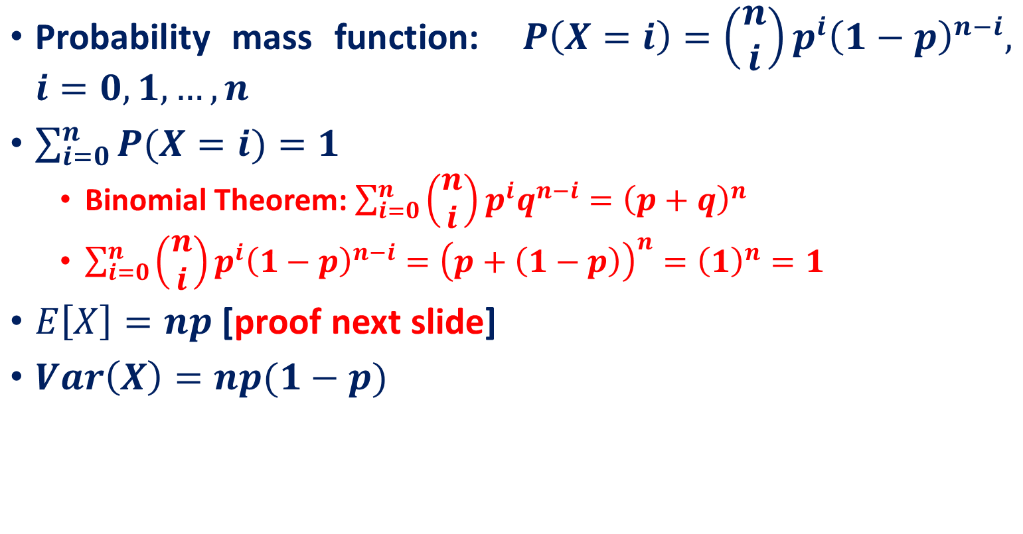
Properties
Probability mass function: $P\left(X=i\right)=\left(\begin{aligned}n \\ i\end{aligned}\right)p^{i}{\left(1−p\right)}^{n−i}, i=0, 1, …,n$
$\sum_{i=0}^{n}{P(X=i)}=1$
Binomial Theorem: $\sum_{i=0}^{n}{\left(\begin{aligned}n \\ i\end{aligned}\right)p^{i}q^{n−i}={\left(p+q\right)}^{n}}$
$\sum_{i=0}^{n}{\left(\begin{aligned}n \\ i\end{aligned}\right)p^{i}{\left(1−p\right)}^{n−i}}={\left(p+\left(1−p\right)\right)}^{n}={\left(1\right)}^{n}=1$
$E\left[X\right]=np$ [proof next slide]
$Var\left(X\right)=np(1−p)$

Slide 21
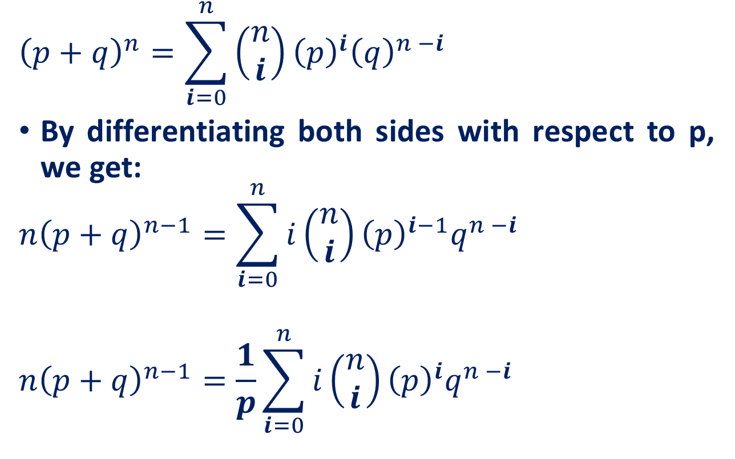
Binomial random variable
$${\left(p+q\right)}^{n}=\sum_{i=0}^{n}{\left(\begin{matrix}n \\ i\end{matrix}\right){\left(p\right)}^{i}{\left(q\right)}^{n −i}}$$
By differentiating both sides with respect to p, we get:
$$n{\left(p+q\right)}^{n−1}=\sum_{i=0}^{n}{i\left(\begin{matrix}n \\ i\end{matrix}\right){\left(p\right)}^{i−1}q^{n −i}}$$
$$n{\left(p+q\right)}^{n−1}=\frac{1}{p}\sum_{i=0}^{n}{i\left(\begin{matrix}n \\ i\end{matrix}\right){\left(p\right)}^{i}q^{n −i}}$$

Slide 22

Binomial random variable
$$n{\left(p+q\right)}^{n−1}=\frac{1}{p}\sum_{i=0}^{n}{i\left(\begin{matrix}n \\ i\end{matrix}\right){\left(p\right)}^{i}q^{n −i}}$$
Substitute $q=1−p$
$$np=\sum_{i=0}^{n}{i\left(\begin{matrix}n \\ i\end{matrix}\right){\left(p\right)}^{i}q^{n −i}}$$

Slide 23
Poisson Distribution
Number of events that occur in an interval
events per unit
Time, Length, Area, Space
Examples
Number of customers arriving in 20 minutes
Number of strikes per year in the India.
Number of defects per lot (group) of DVD’s

Slide 24
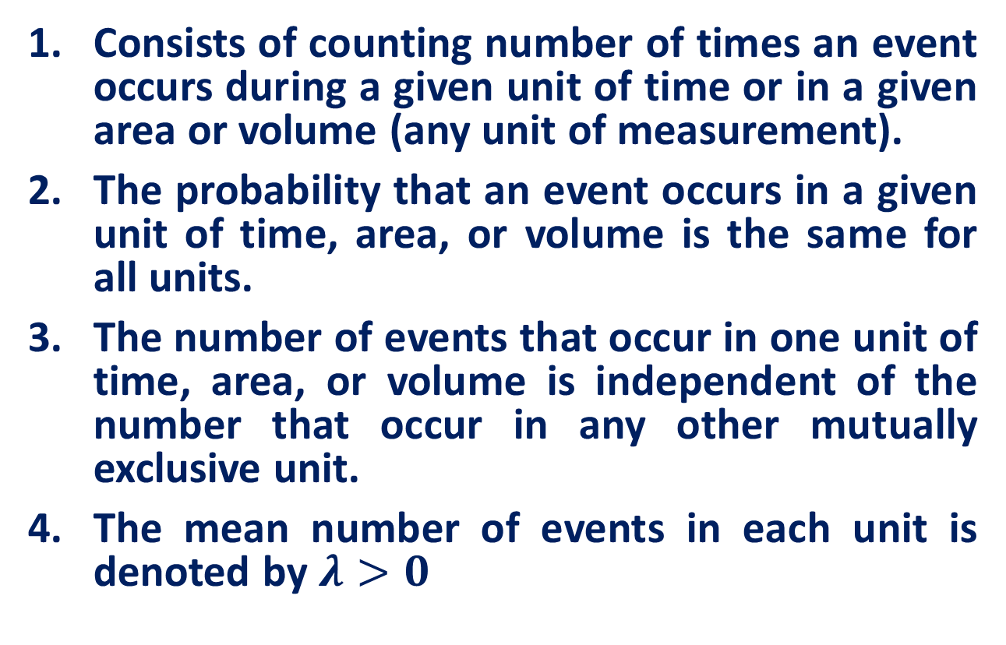
Poisson Distribution
Consists of counting number of times an event occurs during a given unit of time or in a given area or volume (any unit of measurement).
The probability that an event occurs in a given unit of time, area, or volume is the same for all units.
The number of events that occur in one unit of time, area, or volume is independent of the number that occur in any other mutually exclusive unit.
The mean number of events in each unit is denoted by $λ>0$

Slide 25
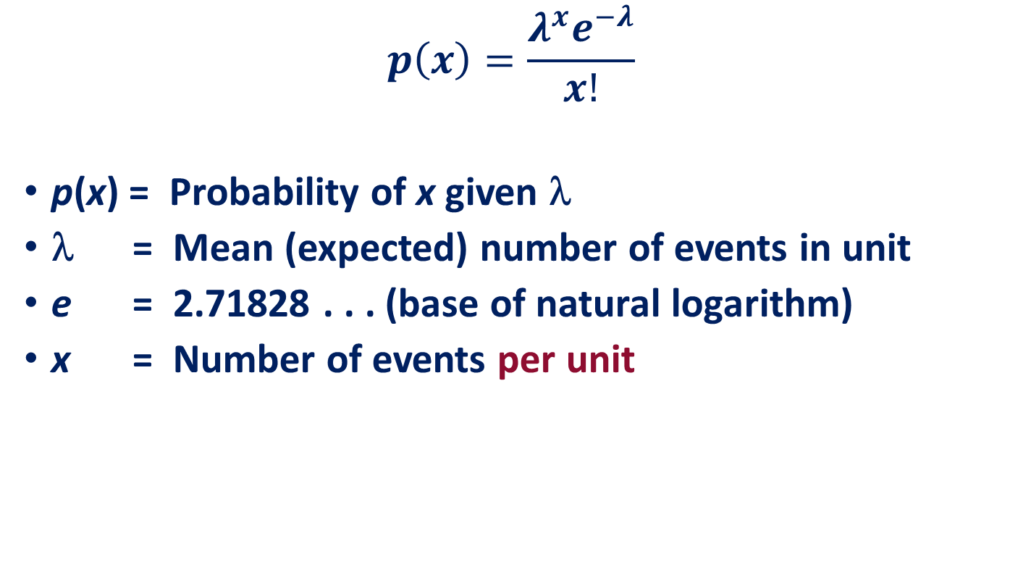
Poisson Probability Distribution Function
$$p\left(x\right)=\frac{λ^{x}e^{−λ}}{x!}$$
p(x) = Probability of x given λ
λ = Mean (expected) number of events in unit
e = 2.71828 . . . (base of natural logarithm)
x = Number of events per unit

Slide 26

Poisson Distribution
Customers arrive at a rate of 72 per hour. What is the probability of 4 customers arriving in 3 minutes?
Solution
72 Per Hr. = 1.2 Per Min. = 3.6 Per 3 Min. Interval
$$p(x)=\frac{ λ^{x}e^{−λ} }{x!} \\ p(4)=\frac{{\left(3.6\right)}^{4}e^{−3\text{.6}}}{4!}=\text{.1912}$$

Slide 27
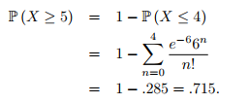
Poisson Distribution
Bob receives texts on the average of two every 3 minutes. Assume Poisson.
Question: What is the probability of five or more texts arriving in a 9−minute period

Slide 28
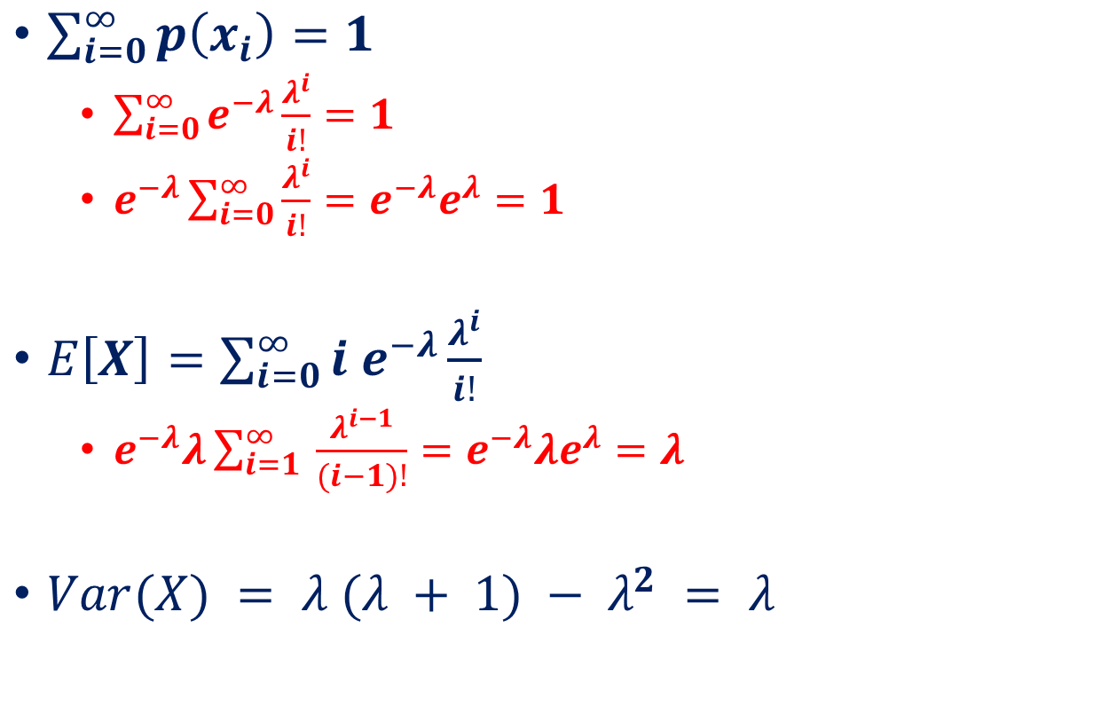
Properties of Poisson Distribution
$\sum_{i=0}^{∞}{p\left(x_{i}\right)=1}$
$\sum_{i=0}^{∞}{e^{−λ}\frac{λ^{i}}{i!}}=1$
$e^{−λ}\sum_{i=0}^{∞}{\frac{λ^{i}}{i!}=e^{−λ}e^{λ}=1}$
$E\left[X\right]=\sum_{i=0}^{∞}{i e^{−λ}\frac{λ^{i}}{i!}}$
$e^{−λ}λ\sum_{i=1}^{∞}{ \frac{λ^{i−1}}{(i−1)!}=e^{−λ}λe^{λ}=λ}$
$Var(X) = λ (λ + 1) − λ^{2} = λ$

Slide 29
Recall: Uniform discrete random variable
We say $X$ is uniform, and write this as $X\sim uniform(n)$, if $X∈\left\{x_{1},x_{2},…,x_{n}\right\}$
$$p\left(x_{i}\right)=P\left(X=x_{i}\right)=\frac{1}{n}, for i=1,2,…,n$$
$E\left[X\right]=\frac{x_{1}+x_{2}+…+x_{n}}{n}$
$Var\left(X\right)=\frac{x_{1}^{2}+x_{2}^{2}+…+x_{n}^{2}}{n}−{\left(\frac{x_{1}+x_{2}+…+x_{n}}{n}\right)}^{2}$
Example
Let X be the number shown on a rolled fair die. Then X follow uniform distribution

Slide 30
Recall: Binomial random variable
Characteristics of a Binomial Experiment
The experiment consists of n independent identical trials.
There are only two possible outcomes on each trial. We will denote one outcome by S (for success) and the other by F (for failure).
The probability of S remains the same from trial to trial. This probability is denoted by p, and the probability of F is denoted by q. Note that q = 1 – p.
The binomial random variable $X$ is the number of S’s in n trials.
$$P\left(X=i\right)=\left(\begin{aligned}n \\ i\end{aligned}\right)p^{i}{\left(1−p\right)}^{n−i},$$

Slide 31
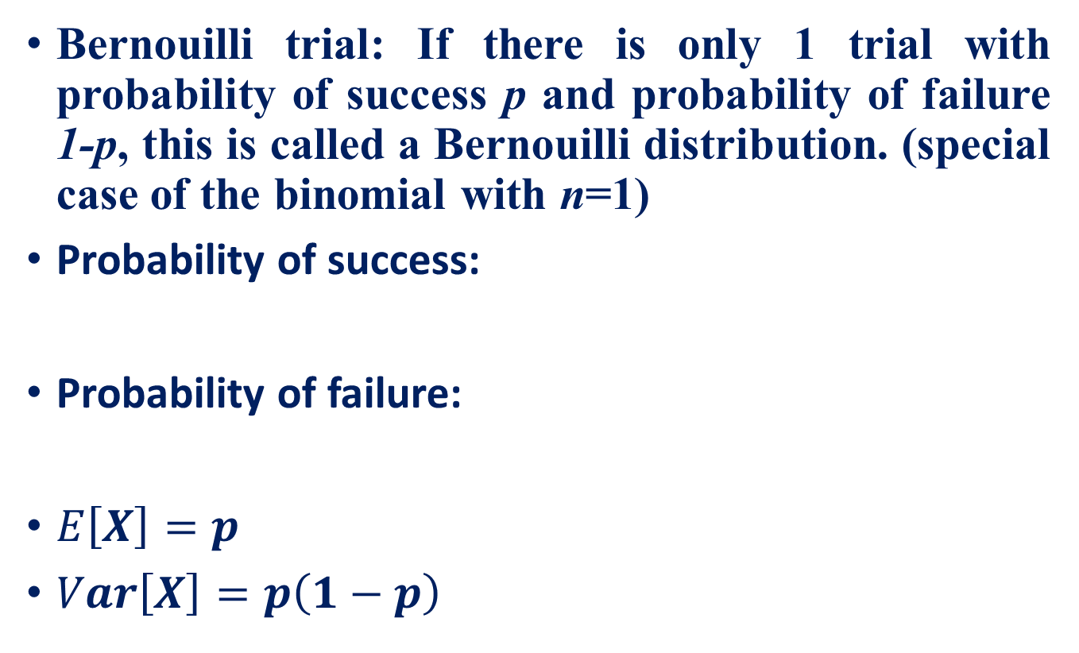
Recall: Bernoulli random variable
Bernouilli trial: If there is only 1 trial with probability of success p and probability of failure 1-p, this is called a Bernouilli distribution. (special case of the binomial with n=1)
Probability of success:
Probability of failure:
$E\left[X\right]=p$
$Var\left[X\right]=p\left(1−p\right)$

Slide 32
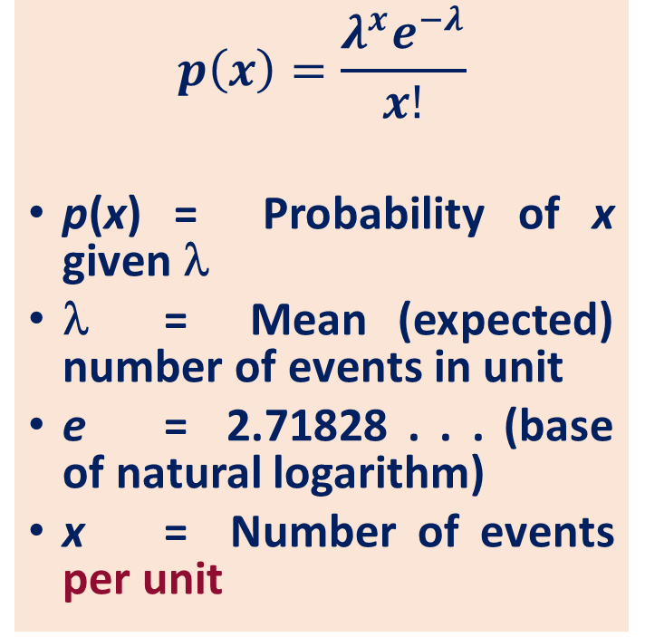
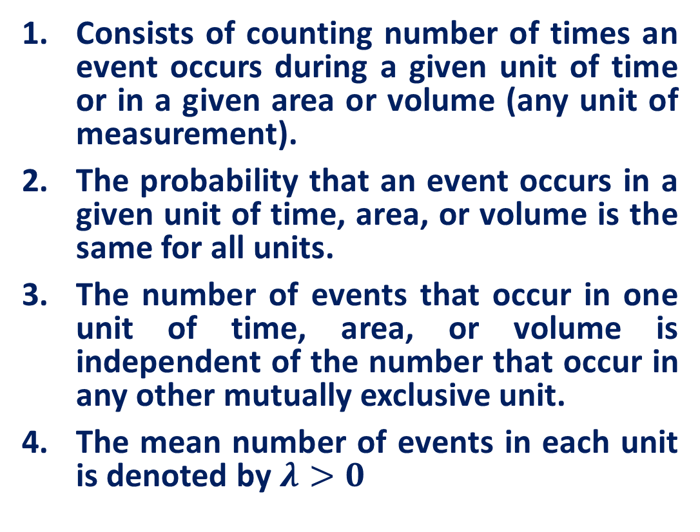
Recall: Poisson Distribution
Consists of counting number of times an event occurs during a given unit of time or in a given area or volume (any unit of measurement).
The probability that an event occurs in a given unit of time, area, or volume is the same for all units.
The number of events that occur in one unit of time, area, or volume is independent of the number that occur in any other mutually exclusive unit.
The mean number of events in each unit is denoted by $λ>0$
$$p\left(x\right)=\frac{λ^{x}e^{−λ}}{x!}$$
p(x) = Probability of x given λ
λ = Mean (expected) number of events in unit
e = 2.71828 . . . (base of natural logarithm)
x = Number of events per unit

Slide 33
Practice Example
As voters exit the polls, you ask a representative random sample of 6 voters if they voted for xyz. If the true percentage of voters who vote for xyz is 55.1%, what is the probability that, in your sample, exactly 2 voted for xyz and 4 did not?
$$P(2 yes votes exactly) =\left(\begin{aligned}6 \\ 2\end{aligned}\right)× (.551)2×(.449)4= 18.5\%$$

Slide 34
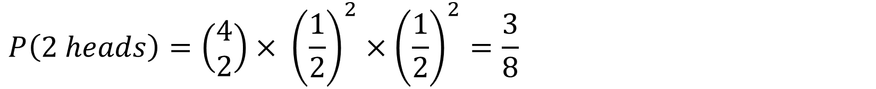
Practice Example
Four fair coins are flipped. If the outcomes are assumed independent, what is the probability that two heads and two tails are obtained?
$$P\left(2 heads\right)=\left(\begin{aligned}4 \\ 2\end{aligned}\right)× {\left(\frac{1}{2}\right)}^{2}×{\left(\frac{1}{2}\right)}^{2}=\frac{3}{8}$$

Slide 35
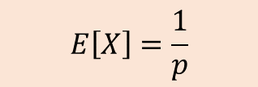
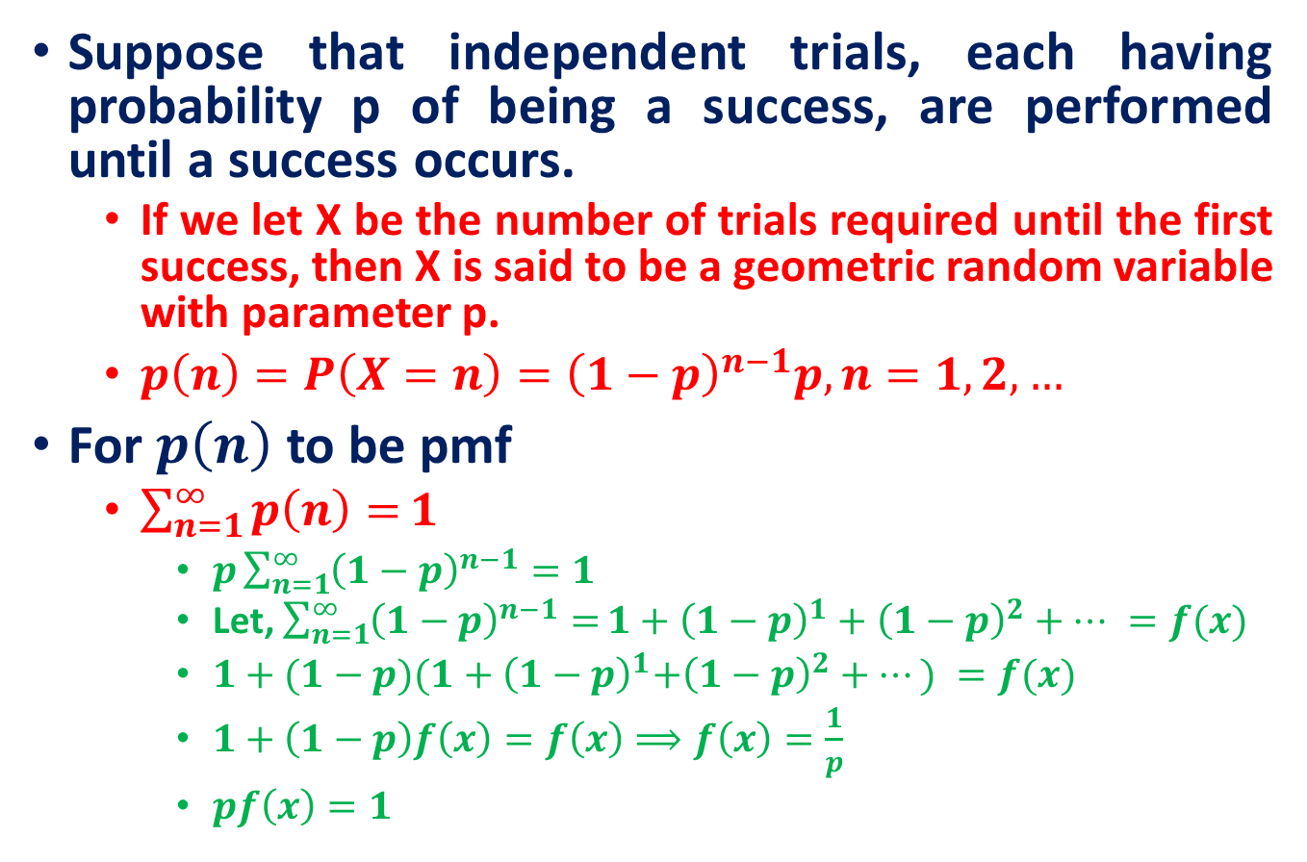
Geometric Distribution
Suppose that independent trials, each having probability p of being a success, are performed until a success occurs.
If we let X be the number of trials required until the first success, then X is said to be a geometric random variable with parameter p.
$p\left(n\right)=P\left(X=n\right)={\left(1−p\right)}^{n−1}p, n=1,2,…$
For $p\left(n\right)$ to be pmf
$\sum_{n=1}^{∞}{p\left(n\right)=}1$
$p\sum_{n=1}^{∞}{{\left(1−p\right)}^{n−1}=1}$
Let, $\sum_{n=1}^{∞}{{\left(1−p\right)}^{n−1}=}1+{\left(1−p\right)}^{1}+{\left(1−p\right)}^{2}+… =f(x)$
$1+{(1−p)(1+\left(1−p\right)}^{1}+{\left(1−p\right)}^{2}+…) =f(x)$
$1+\left(1−p\right)f\left(x\right)=f\left(x\right)⟹f\left(x\right)=\frac{1}{p}$
$pf\left(x\right)=1$
$$E\left[X\right]=\frac{1}{p}$$

Slide 36
Negative Binomial
Binomial:
Fixed number of n trials.
Each trial is independent.
Only two outcomes are possible (Success and Failure).
Probability of success (p) for each trial is constant.
A random variable Y= the number of successes.
Negative Binomial
The number of trials, n is not fixed.
Each trial is independent.
Only two outcomes are possible (Success and Failure).
Probability of success (p) for each trial is constant.
A random variable Y= the number of trials needed to make r successes.

Slide 37
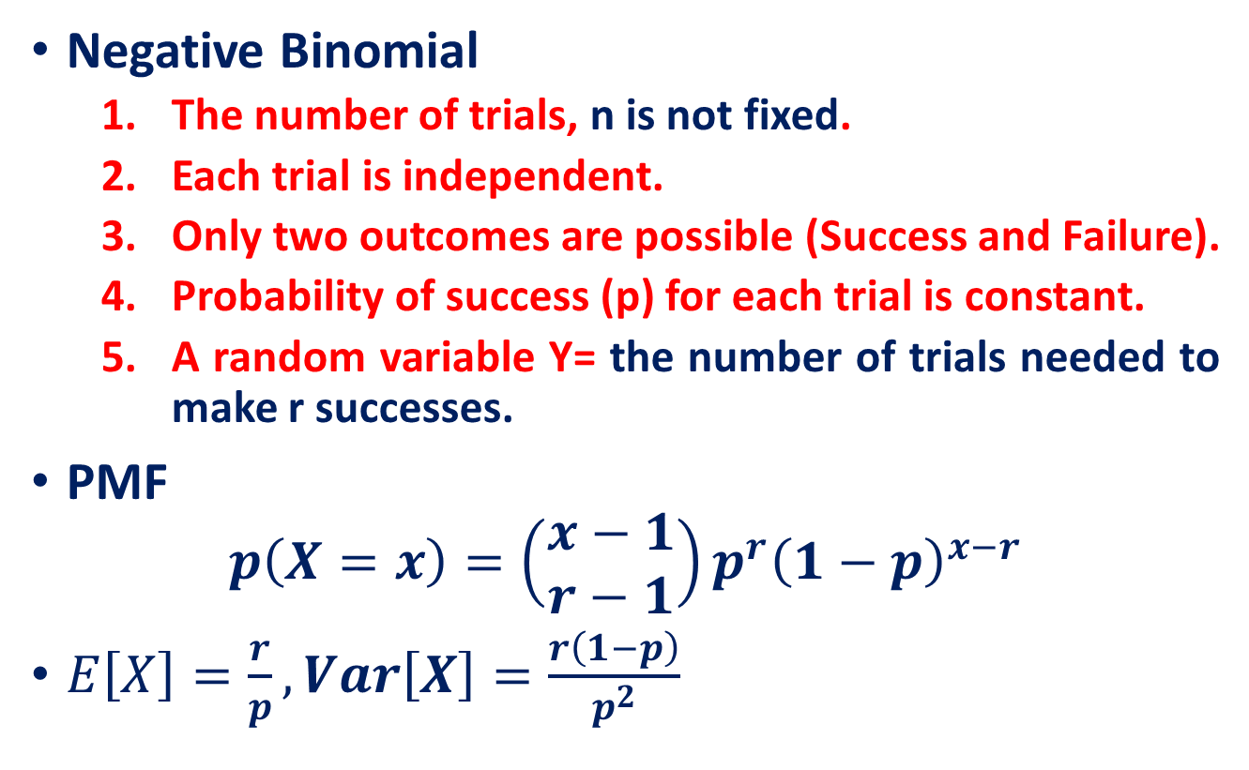
Negative Binomial
Negative Binomial
The number of trials, n is not fixed.
Each trial is independent.
Only two outcomes are possible (Success and Failure).
Probability of success (p) for each trial is constant.
A random variable Y= the number of trials needed to make r successes.
PMF
$$p\left(X=x\right)=\left(\begin{aligned}x−1 \\ r−1\end{aligned}\right)p^{r}{\left(1−p\right)}^{x−r}$$
$E\left[X\right]=\frac{r}{p},Var\left[X\right]=\frac{r\left(1−p\right)}{p^{2}}$

Slide 38
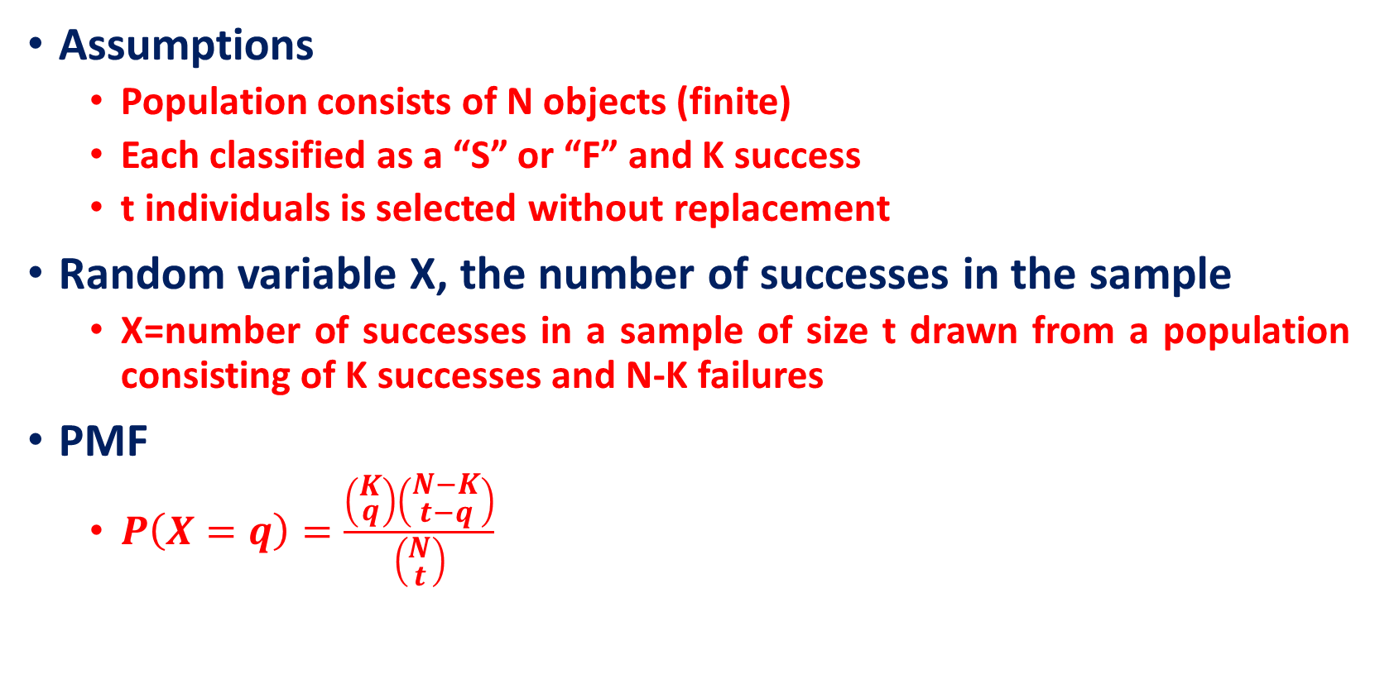
Hypergeometric Distribution
Assumptions
Population consists of N objects (finite)
Each classified as a “S” or “F” and K success
t individuals is selected without replacement
Random variable X, the number of successes in the sample
X=number of successes in a sample of size t drawn from a population consisting of K successes and N-K failures
PMF
$P\left(X=q\right)=\frac{\left(\begin{aligned}K \\ q\end{aligned}\right)\left(\begin{aligned}N−K \\ t−q\end{aligned}\right)}{\left(\begin{aligned}N \\ t\end{aligned}\right)}$

Slide 39
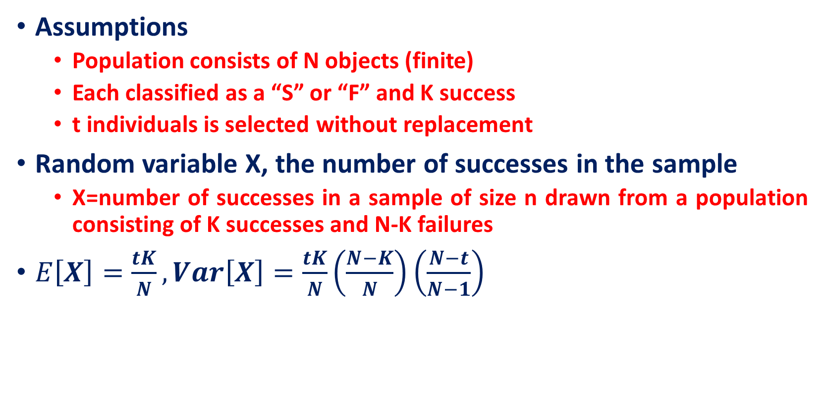
Hypergeometric Distribution
Assumptions
Population consists of N objects (finite)
Each classified as a “S” or “F” and K success
t individuals is selected without replacement
Random variable X, the number of successes in the sample
X=number of successes in a sample of size n drawn from a population consisting of K successes and N-K failures
$E\left[X\right]=\frac{tK}{N}, Var\left[X\right]=\frac{tK}{N}\left(\frac{N−K}{N}\right)\left(\frac{N−t}{N−1}\right)$

Slide 40
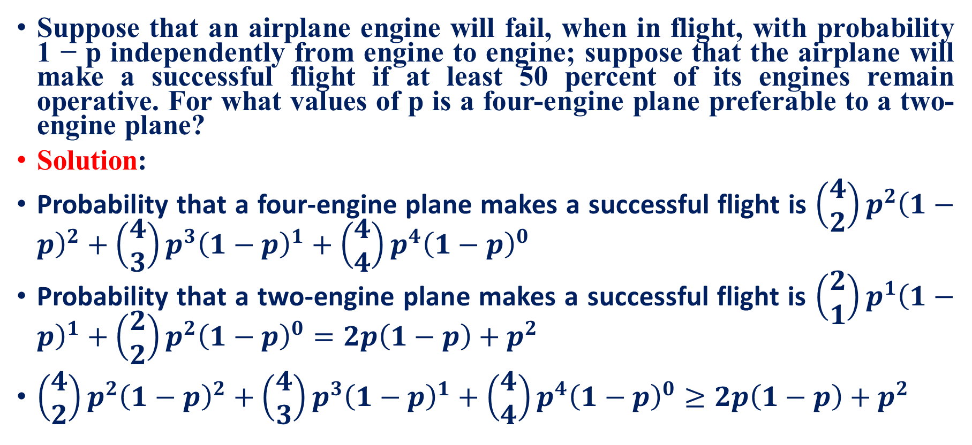
Practice Example
Suppose that an airplane engine will fail, when in flight, with probability 1 − p independently from engine to engine; suppose that the airplane will make a successful flight if at least 50 percent of its engines remain operative. For what values of p is a four-engine plane preferable to a two-engine plane?
Solution:
Probability that a four-engine plane makes a successful flight is $\left(\begin{aligned}4 \\ 2\end{aligned}\right)p^{2}{\left(1−p\right)}^{2}+\left(\begin{aligned}4 \\ 3\end{aligned}\right)p^{3}{\left(1−p\right)}^{1}+\left(\begin{aligned}4 \\ 4\end{aligned}\right)p^{4}{\left(1−p\right)}^{0}$
Probability that a two-engine plane makes a successful flight is $\left(\begin{aligned}2 \\ 1\end{aligned}\right)p^{1}{\left(1−p\right)}^{1}+\left(\begin{aligned}2 \\ 2\end{aligned}\right)p^{2}{\left(1−p\right)}^{0}=2p\left(1−p\right)+p^{2}$
$\left(\begin{aligned}4 \\ 2\end{aligned}\right)p^{2}{\left(1−p\right)}^{2}+\left(\begin{aligned}4 \\ 3\end{aligned}\right)p^{3}{\left(1−p\right)}^{1}+\left(\begin{aligned}4 \\ 4\end{aligned}\right)p^{4}{\left(1−p\right)}^{0}≥2p\left(1−p\right)+p^{2}$

Slide 41
Reference
Lecture notes on Probability Theory by Phanuel Mariano
Schaum's Outline of Probability and Statistics, 4th Edition

